Slide 1

Thermodynamics and Heat Transfer Project – Group C
Performance of a Single-Cylinder
Compression Ignition Engine
Members:
Nguyen Xuan Binh, William Bergman Jaime Montero de la Plaza
Lucas Foley, Niklas Sterpi
Notes:
Niklas Tot 5min

Slide 2
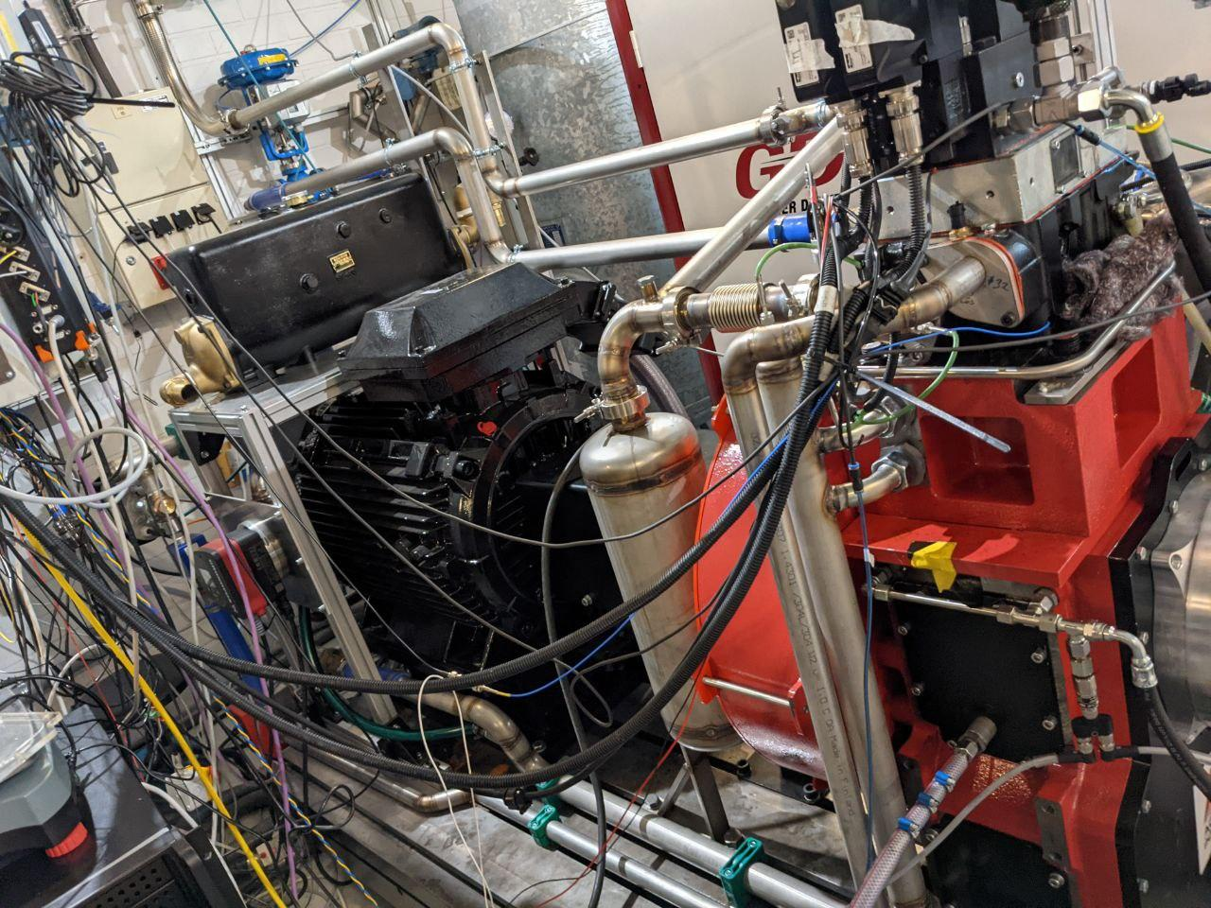
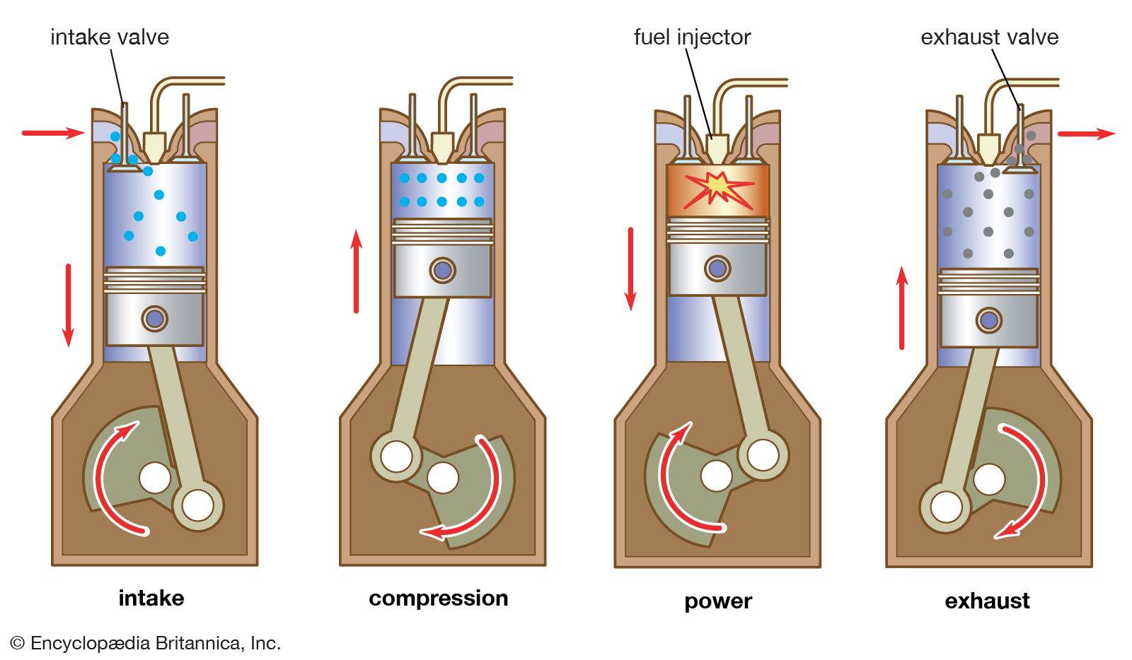
Introduction
Notes:
Niklas

Slide 3
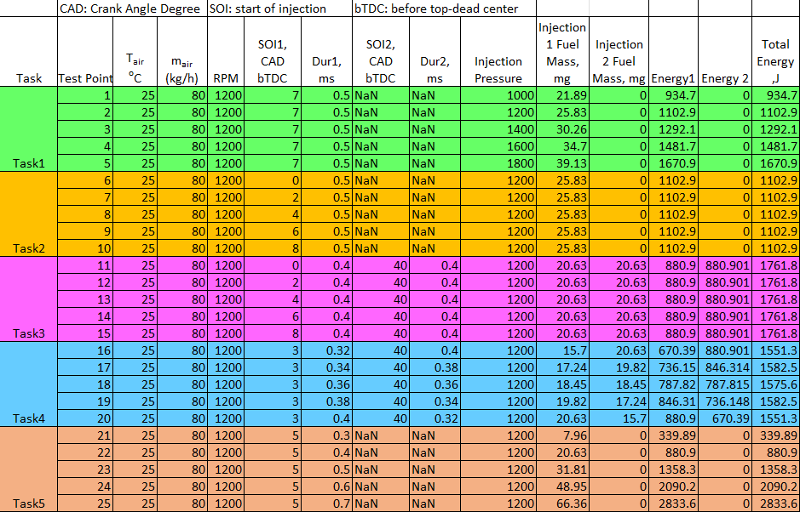
In our project, we conduct the performance of the ignition engine in 5 different tasks
Task 1: (Single-injection) Difference in Injection Pressure
Task 2: (Single-injection) Difference in Start of Injection 1 measured in Crank angles before top-dead center
Task 3: (Dual-injection) Difference in SOI 1 measured in CAD bTDC for the first fuel. Same injection pressure, fuel mass for both fuels
Task 4: (Dual-injection) Difference in the fuel mass and the injection duration for the two fuels
Task 5: (Single-injection) Difference in the fuel mass and the injection duration
Notes:
Niklas

Slide 4

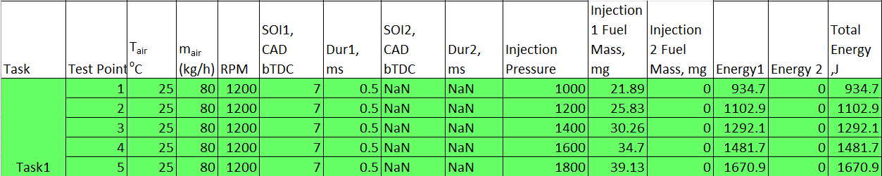
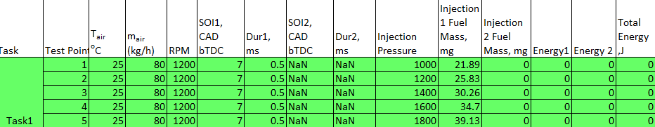
Task 1
(Single-injection) Difference in Injection Pressure
Notes:
Niklas

Slide 5
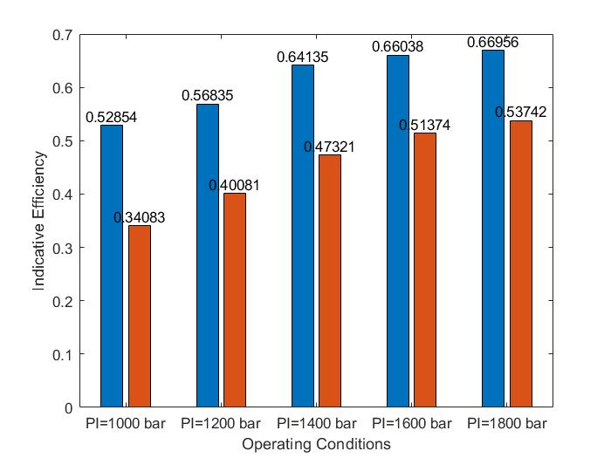
Task 1 Indicative Efficiency
Notes:
Blue Our own calculations. Orange Dewesoft.
Niklas

Slide 6
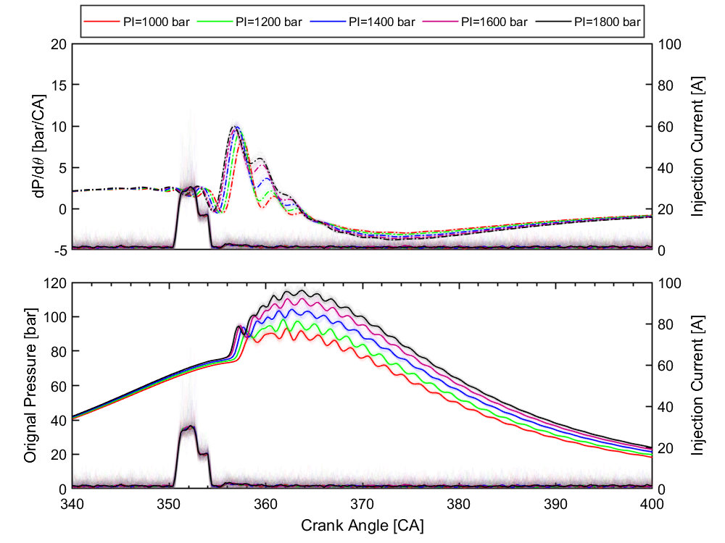
Task 1 dP/dθ and Original Pressure
Notes:
Niklas

Slide 7
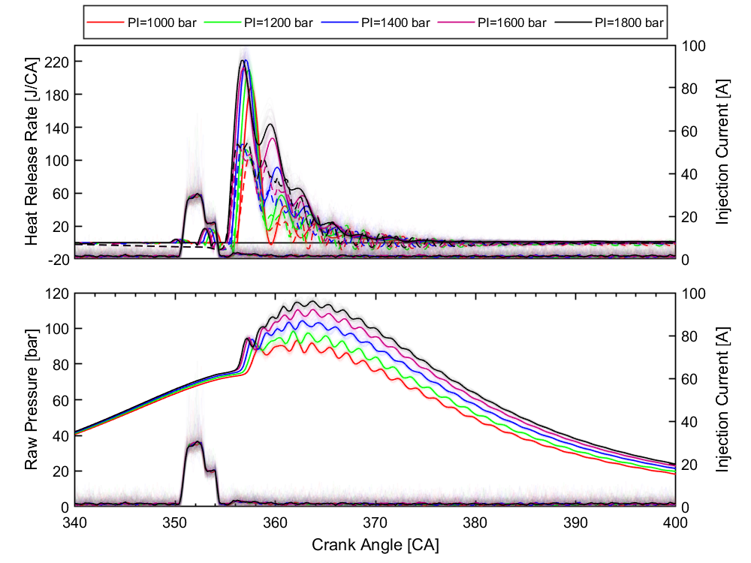
Task 1 HRR and Raw Pressure
Notes:
Niklas

Slide 8
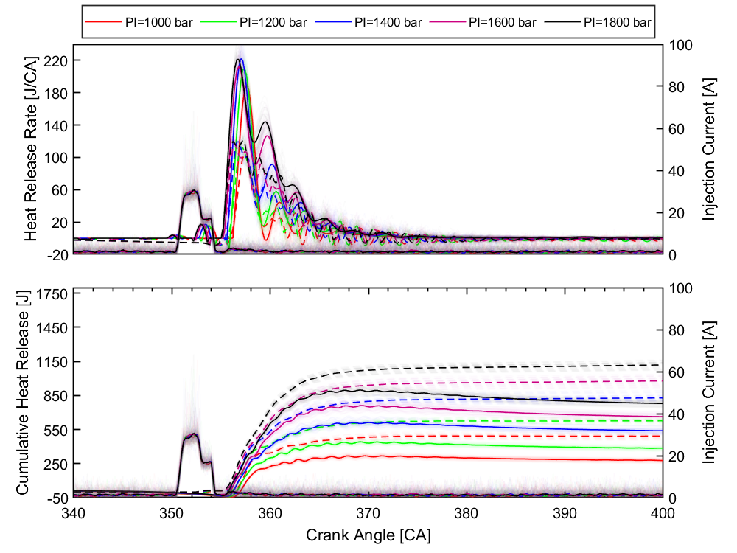
Task 1 HRR - CHR
Notes:
Niklas

Slide 9
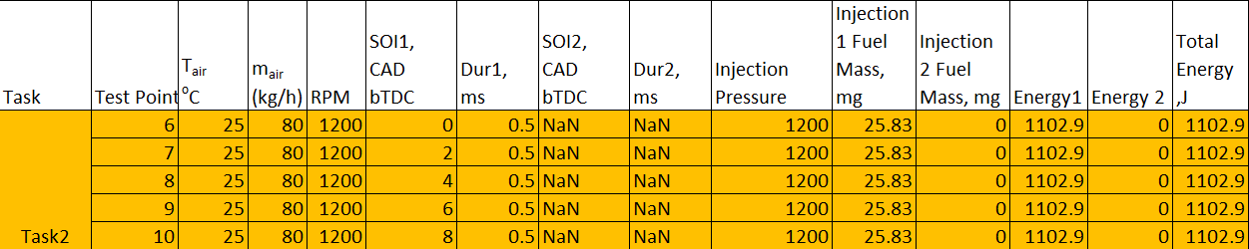
Task 2
(Single-injection) Difference in Start of Injection 1 measured in Crank angles before top-dead center
Notes:
Jaime 2min

Slide 10
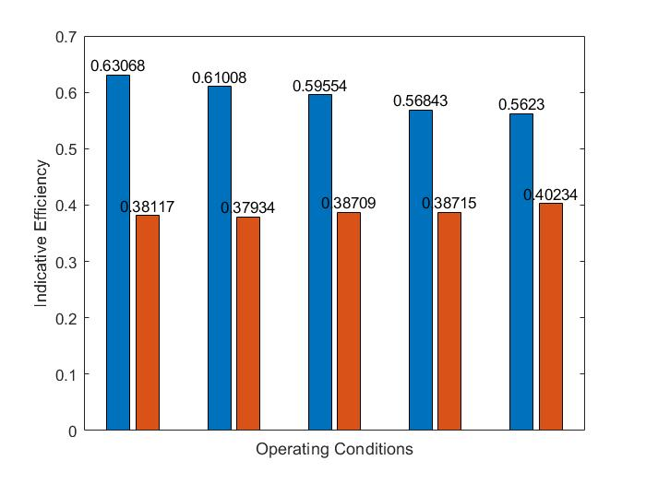
Task 2 Indicative Efficiency
Notes:
Blue Our own calculations. Orange Dewesoft.
Jaime

Slide 11
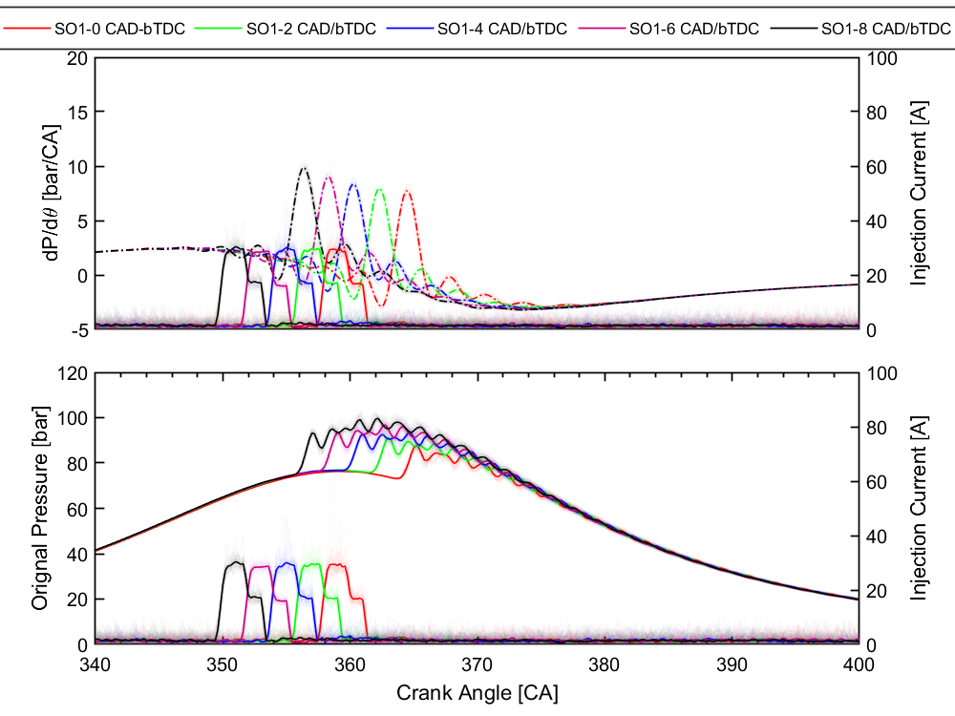
Task 2 dP/dθ and Original Pressure
Notes:
Jaime

Slide 12
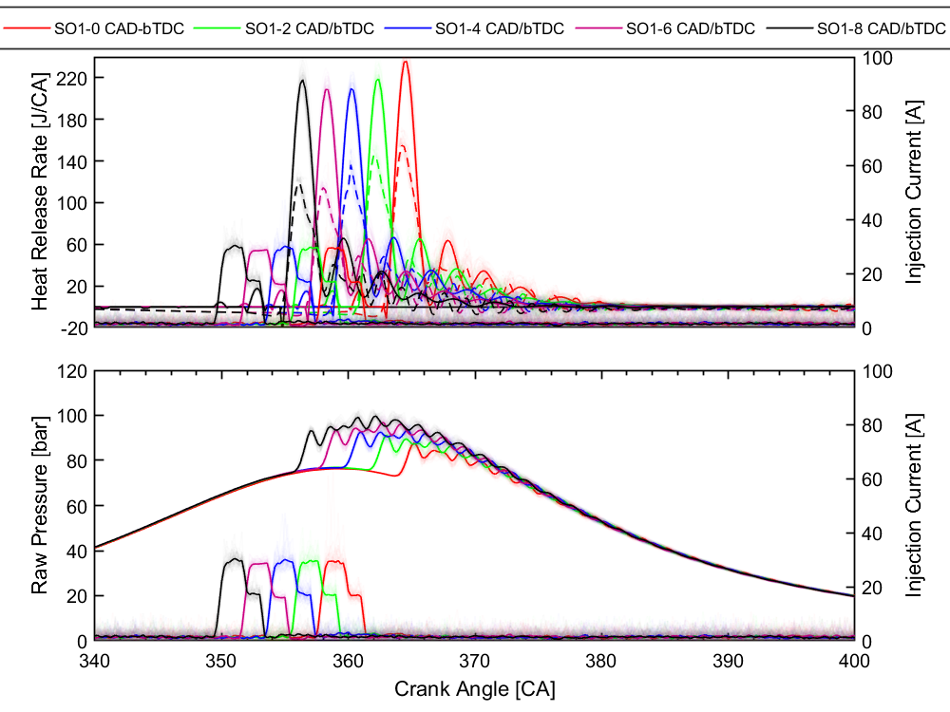
Task 2 HRR and Raw Pressure
Notes:
Jaime

Slide 13
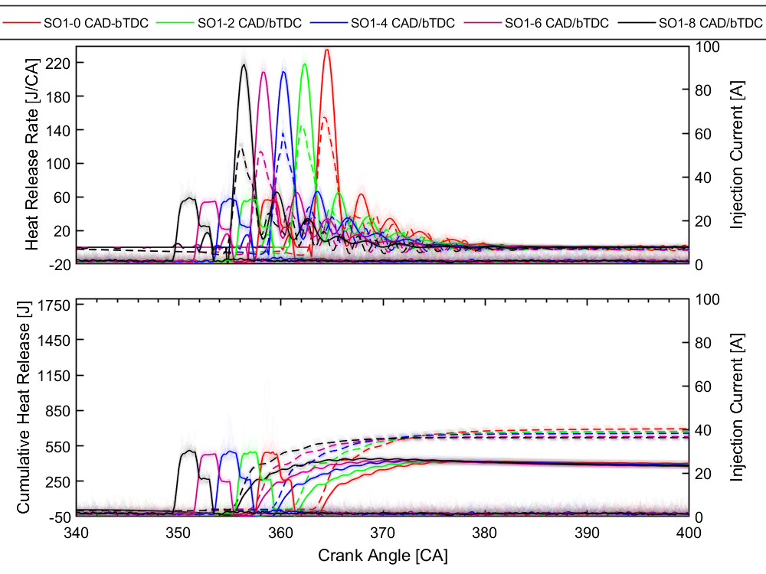
Task 2 HRR - CHR
Notes:
Jaime

Slide 14
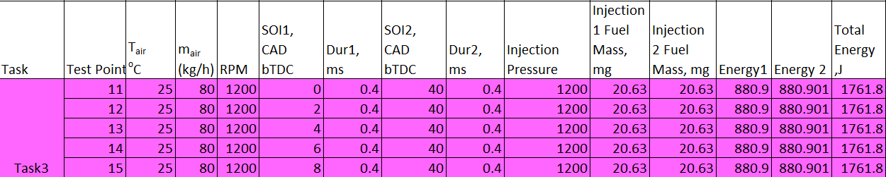
Task 3
(Dual-injection) Difference in Start of Injection 1 measured in CAD bTDC for the first fuel. Same injection pressure and fuel mass for both fuels
Notes:
Binh 5min

Slide 15
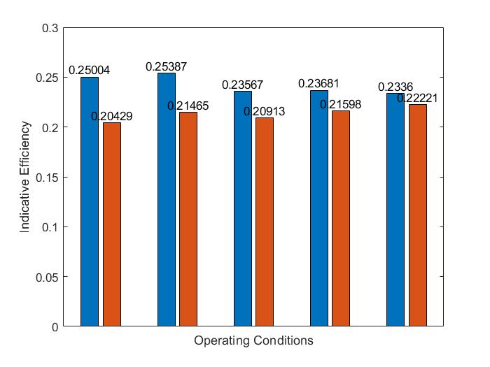
Task 3 Indicative Efficiency
Notes:
Blue Our own calculations. Orange Dewesoft.
Binh

Slide 16
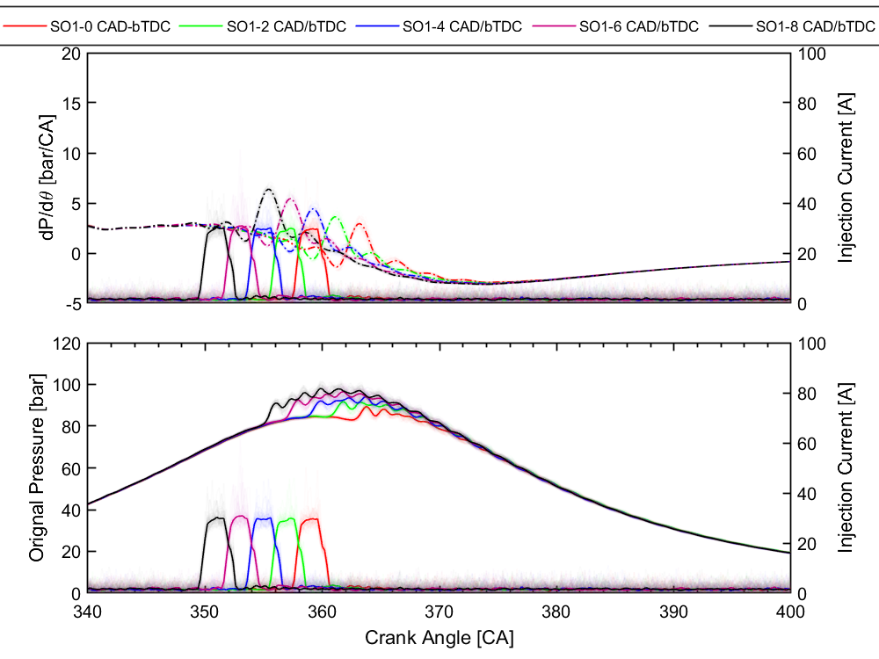
Task 3 dP/dθ and Original Pressure
Notes:
Binh

Slide 17
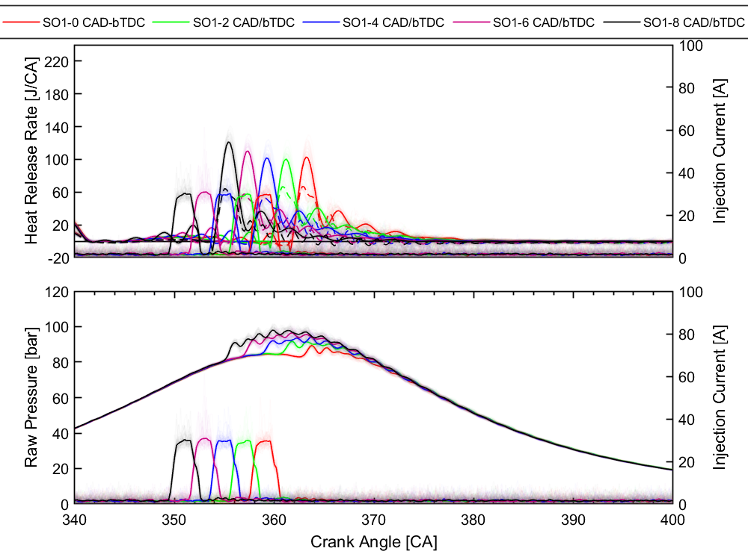
Task 3 HRR and Raw Pressure
Notes:
Binh

Slide 18
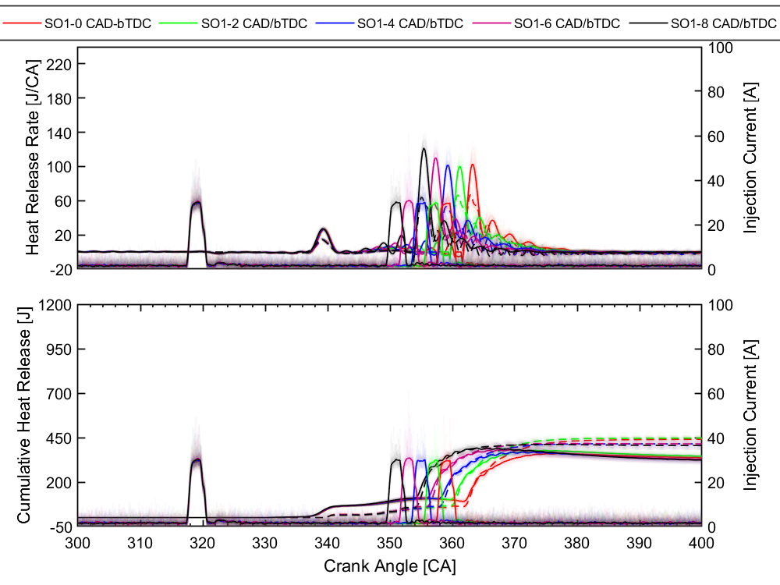
Task 3 HRR - CHR
Notes:
Binh

Slide 19
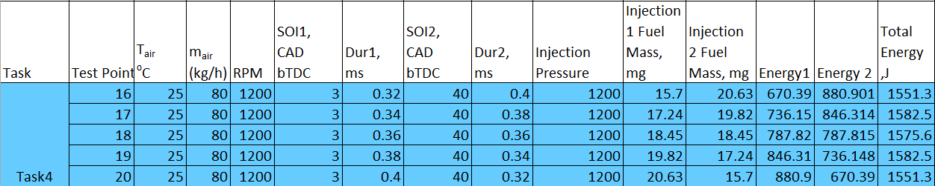
Task 4
(Dual-injection) Difference in the fuel mass and the injection duration for the two fuels
Notes:
Binh

Slide 20
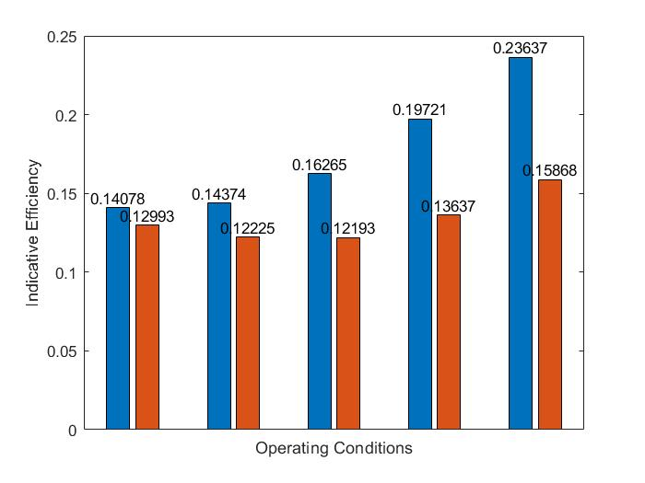
Task 4 Indicative Efficiency
Notes:
Blue Our own calculations. Orange Dewesoft.
Binh

Slide 21
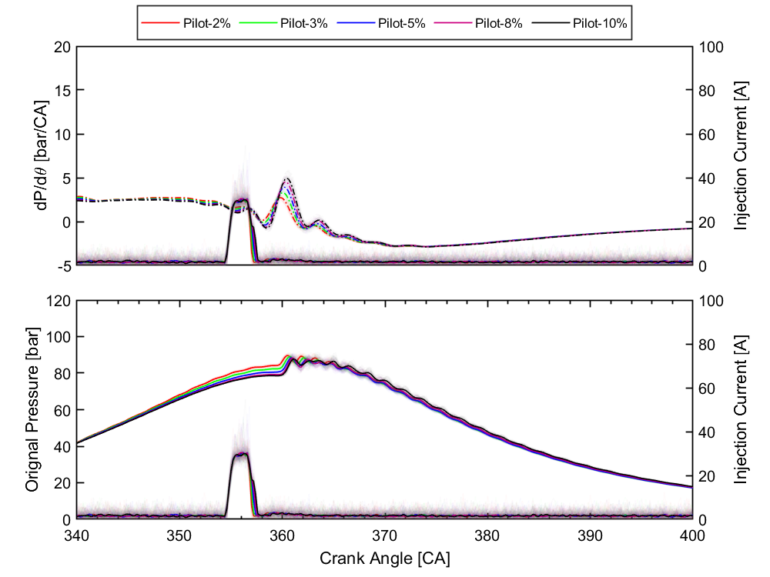
Task 4 dP/dθ and Original Pressure
Notes:
Binh

Slide 22
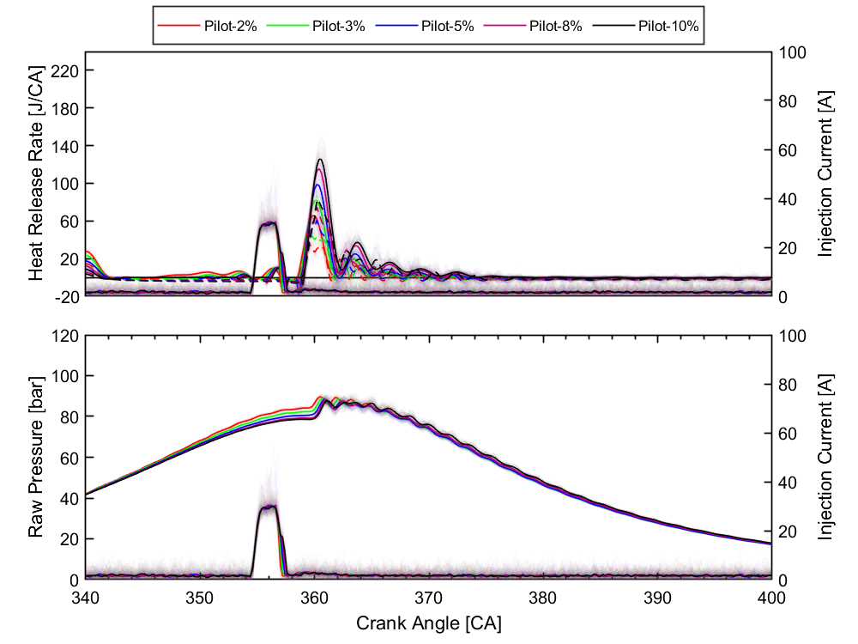
Task 4 HRR and Raw Pressure
Notes:
Binh

Slide 23
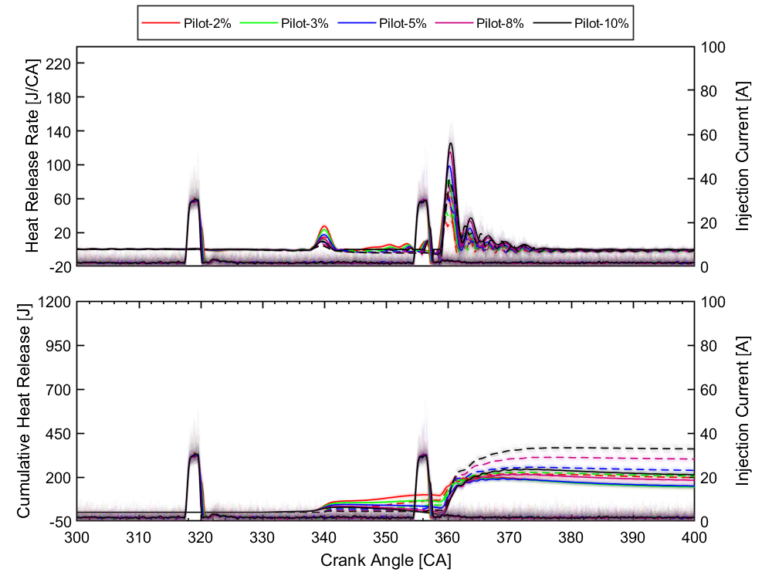
Task 4 HRR - CHR
Notes:
Binh

Slide 24
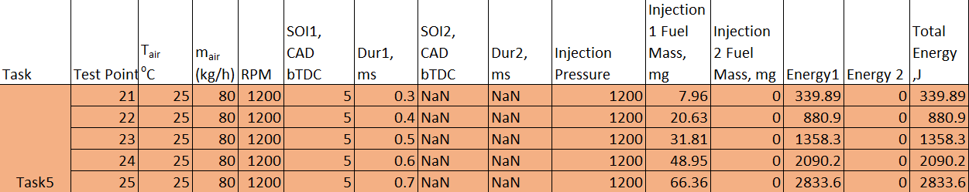
Task 5
(Single-injection) Difference in the fuel mass and the injection duration
Notes:
Lucas 3min

Slide 25
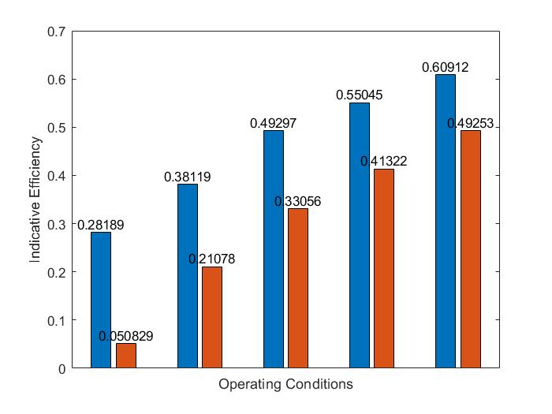
Task 5 Indicative Efficiency
Notes:
Blue Our own calculations. Orange Dewesoft.
Lucas

Slide 26
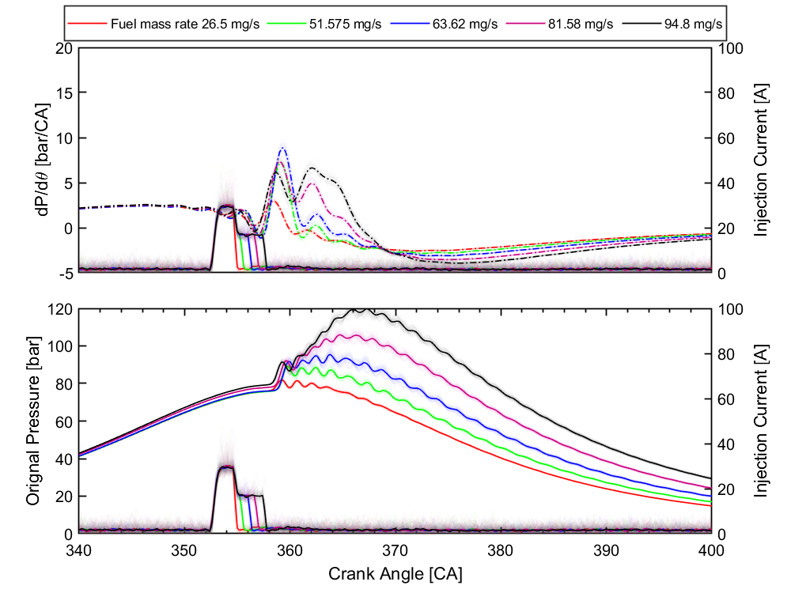
Task 5 dP/dθ and Original Pressure
Notes:
Lucas

Slide 27
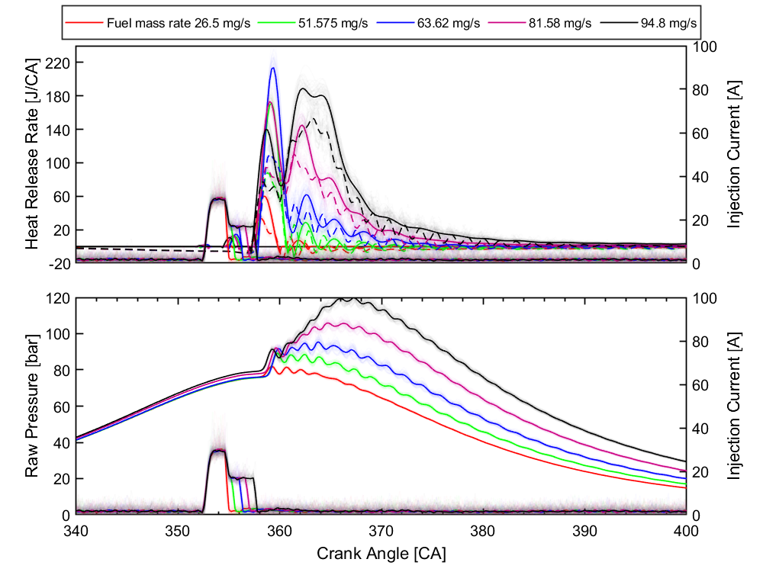
Task 5 HRR and Raw Pressure
Notes:
Lucas

Slide 28
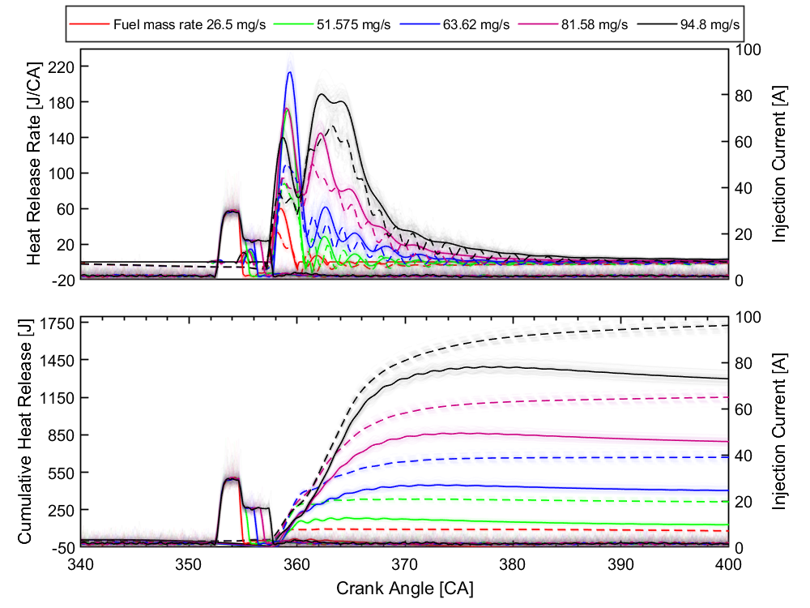
Task 5 HRR - CHR
Notes:
Lucas

Slide 29

Comparison and Summary
Notes:
Lucas

Slide 30
Comparison: Indicative Efficiency
Notes:
Lucas

Slide 31
Comparison: dP/dθ and Original Pressure
Notes:
Lucas

Slide 32
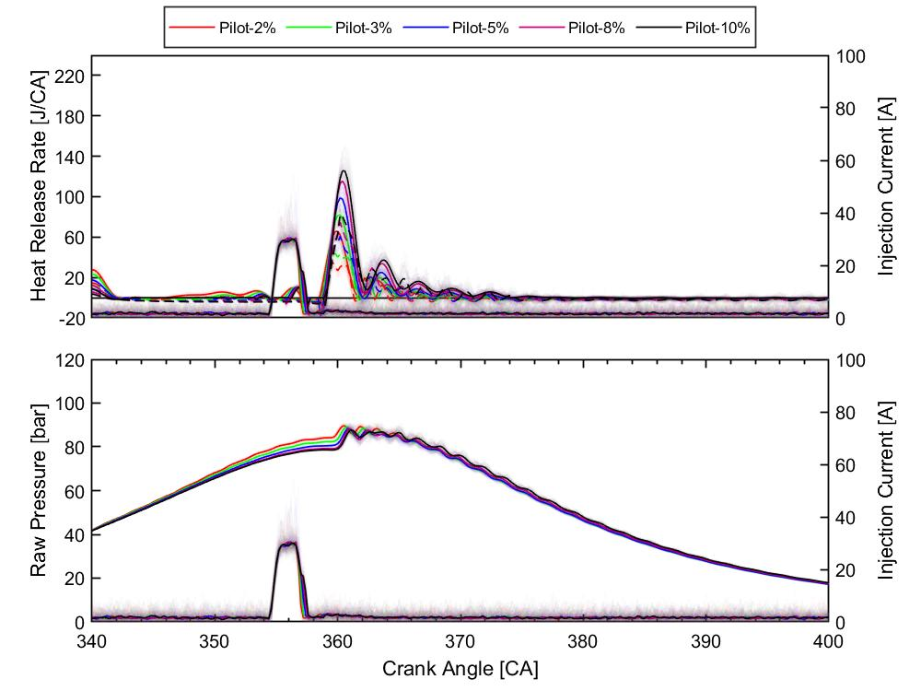
Comparison: HRR and Raw Pressure
Notes:
Lucas

Slide 33

Comparison: HRR - CHR
Notes:
Lucas

Slide 34
Thank you for your participation
in our project presentation!
Do you have any questions?
Notes:
Lucas

